Slide 1
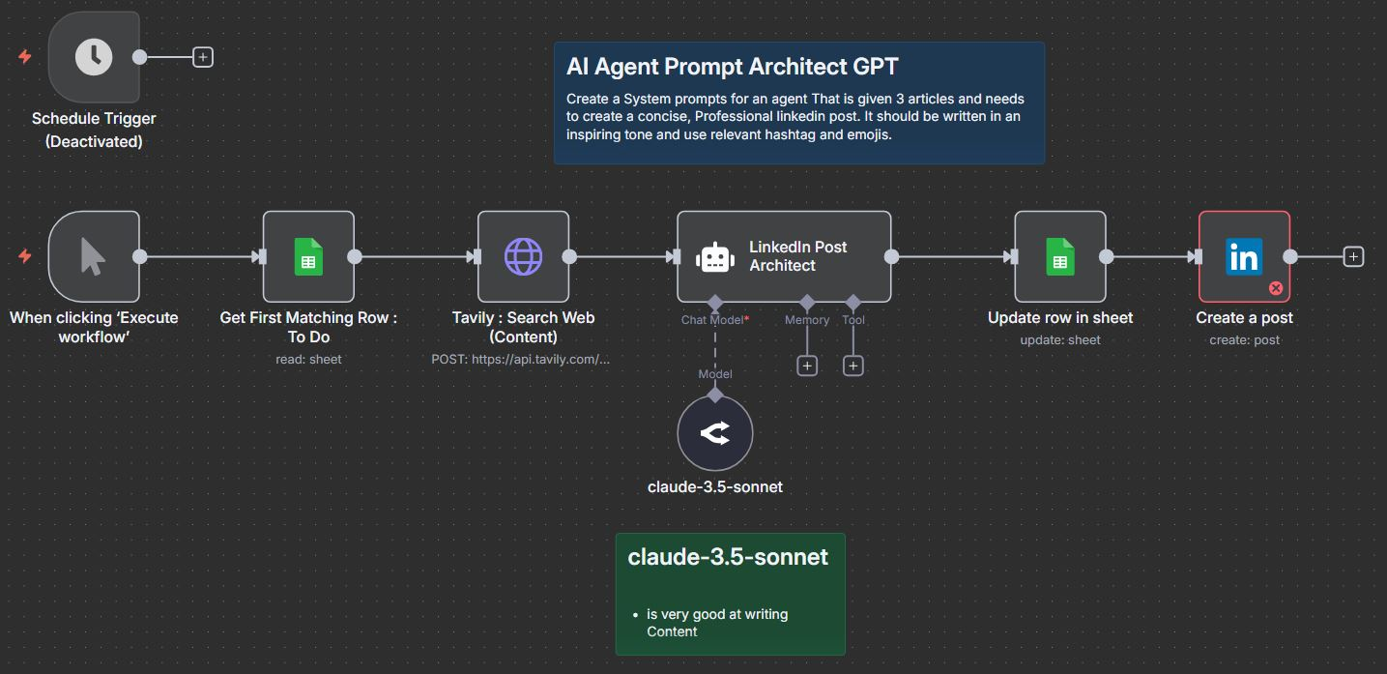
LinkedIn CONTENT CREATOR Automate with n8n & Tavily
Introduction
Building confidence
Engaging the audience
Visual aids
Final tips & takeaways

Slide 2
Manual Process : Wireframe
We know the topic : Automation vs. Creativity
Web Search on that topic : Google
Create a Linked Post
Post Draft
Step 2: Get First matching Row
(Google Sheets)
Filter: Status = To Do
Output : Topic, Status, Category, Row #
Step 3: Tavily Search Web
(HTTP: POST: Tavily)
Query : {{Topic}}
Output : 3 Articles
Step 1 : Trigger
(Scheduled Trigger)
Step 5: Update Rows in Sheet
(Google Sheet)
Match: Topic
Update: Status= Created
Content= Post Draft
Step 4: LinkedIn Post Architect
(AI Agent)
Input: {{3 Articles}}
Output: Post Draft
Tone: Inspiring, Professional
Step 6: Create a Post
(LinkedIn)
Input : Post Draft

Slide 3
Thank you
SACHIN SAVKARE
sachinsavkare08@gmail.com

